Slide 1
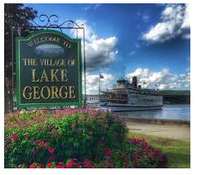
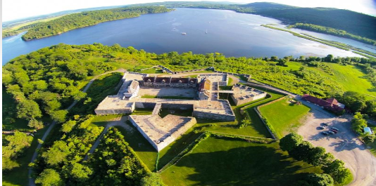
Lake George/Fort Ticonderoga Thursday 8/23 – 8/26 2018

Slide 2
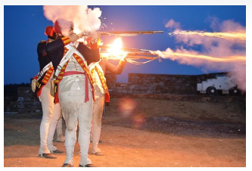
Lake George/Fort Ticonderoga Thursday August 23, 2018
Meet Up at GSP Montvale Service Area – 10:00 am
Arrive at Lake George – approximately 2-2:30 pm
Hotel Check In – see list below
Spend afternoon in Lake George Village
Food – TBD
Shopping
Fort Ticonderoga Guns by Night ($35/pp)
Leave for Fort at 6:15 pm
7:30 pm doors open
90 minute tour and demonstration

Slide 3
Lake George Friday August 24, 2018
Breakfast – TBD
Things To Do
Adirondack Winery
Alisable Chasm Float (must drive to)
Fort William Henry Musuem
Lake George Brew House
Lake George Kayak Company
Lumberjack Pass Mini Golf
The Hyde Collection
Drive to Lunch – Bolton Landing Brewing Company
Drive back to Lake George Village
Dinner - TBD

Slide 4

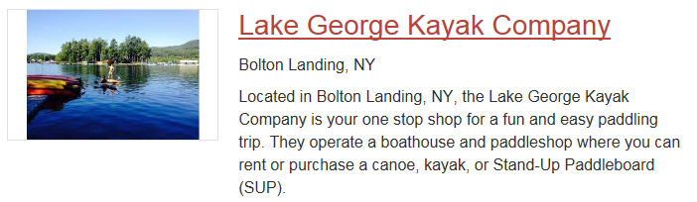

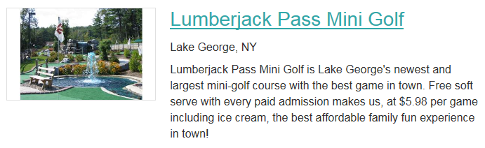
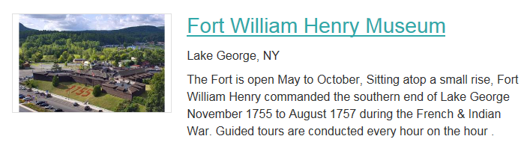
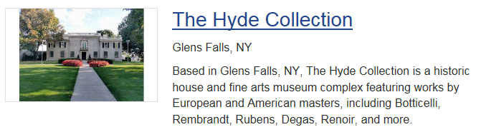
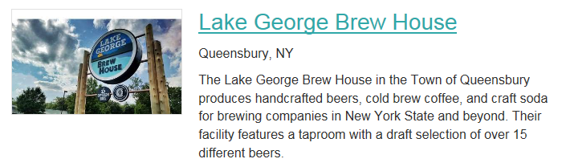
Lake George Things To Do

Slide 5
Fort Ticonderoga Saturday August 25, 2018
Breakfast in Lake George
Leave for Fort
Fort Cafe for late lunch/early dinner – closes at 4:00 pm
Fort Daily Programs ($16/pp) includes
Key to the Continent Tour – 10:15 am, 1:15 pm, 3:00 pm
Musket Firing Demonstrations – 11:00 am
Fort Ticonderoga Museum Tour – 11:30 am and 2:30 pm
Tour of the Historic Gardens – 11:45 am and 2:45 pm
Cannon Firing Demonstrations – 2:00 pm
Mount Defiance: Witness to History Tour – 4:00 pm
Fort Daily Programs + Carillon Boat Tour ($30/pp)
Carillon Boat Tours on Lake Champlain – 1:00 pm, 3:30 pm
Sunset Boat Cruise on Lake Champlain ($35) – 5:30 pm
Lake George for Late Dinner/Drinks

Slide 6
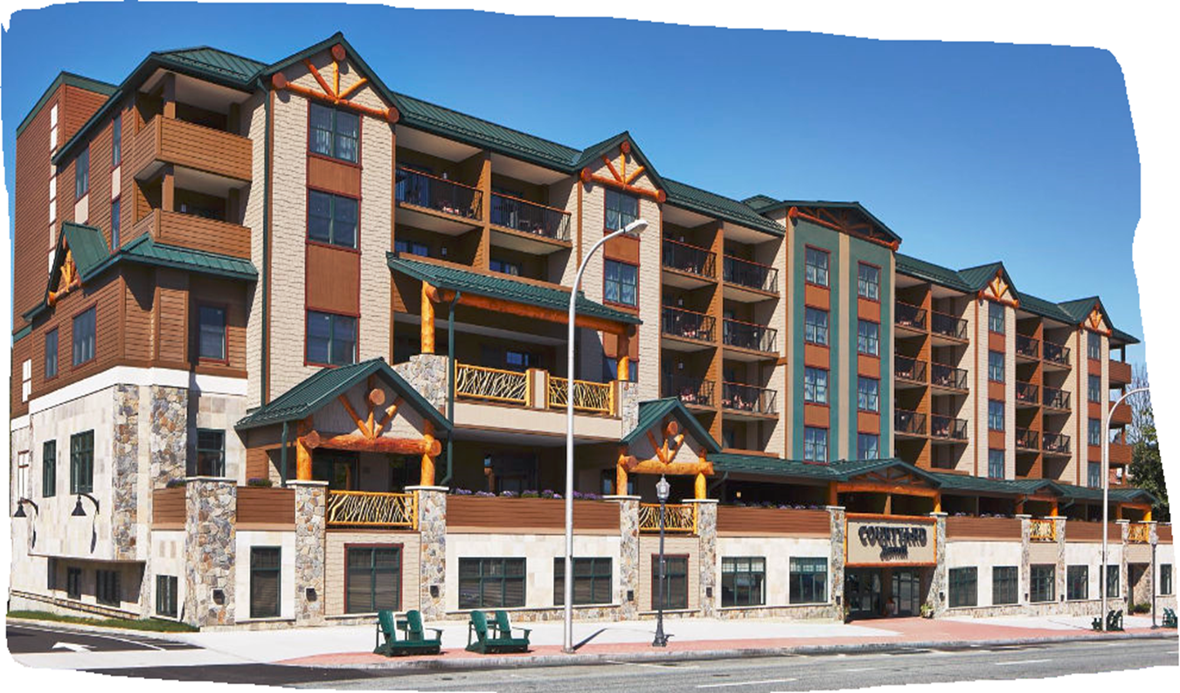
Lake George/Fort Ticonderoga Hotel Options
Courtyard By Marriott, Lake George
365 Canada Street \ Rt. 9N – (518) 761 – 1150
Rates – Thur $269+Tax; Fri-Sat 329+Tax
No Group Rates
Mountain Views \ Lake View @ Higher Rates
King Bed Jr Suites w\Pullout; Double Queens
Rustic Hotel on Main Street \ Modern Decor
Garage (Covered) Parking
On Premise Restaurant \ Bar
Private Function \ Catered Room Available
In Door Pool \ Fitness Center
Walk to all Village Shopping \ Eat’s

Slide 7
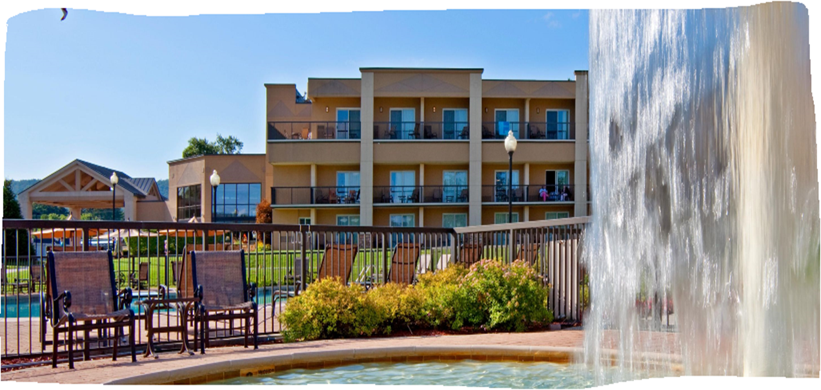
Lake George/Fort Ticonderoga Hotel Options
Holiday Inn, Lake George
2223 Canada Street \ Rt. 9N – (518) 668 – 5781
Rates – Group Rate $269+Tax
Lake \ Mountain Views
Mostly Double Queens
Modern Hotel on Main Street
Family Oriented \ Kids Area
On Premise Restaurant \ Bar
Club Room Available; Order off Hotel Menu
In Door \ Large Out Door Pool \ Fitness Center
A Bit Longer Walk to all Village Shopping \ Eat’s

Slide 8
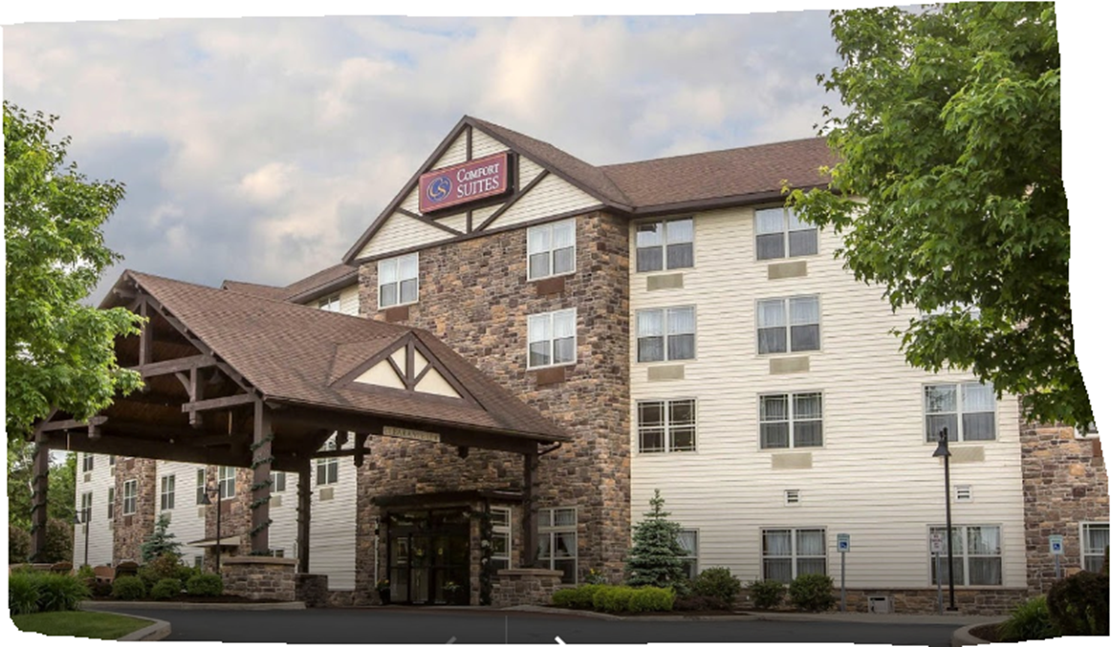
Lake George/Fort Ticonderoga Hotel Options
Comfort Suites, Lake George
1533 Rt. 9 – (518) 761 – 0001
Rates – Group Rate $169+Tax
Mountain \ Country Views
Mostly Double Queens
Value Hotel on Rt 9; Catering To Car Clubs
Complimentary Continental Breakfast
In Door Pool \ Fitness Center
Group Parking w\Buckets and Hose For Car Wash Down
4 Mile Drive to all Village Shopping \ Eat’s
Shuttle service 9:00 am to 10:30 pm - $1/pp
Can Use Breakfast Room in Evening For Private Party

Slide 9


Lake George/Fort Ticonderoga For More Information
https://www.fortticonderoga.org/

